Slide 1
Presenting Hypergro Mobile App

Slide 2
Features
Hypergro provides resources to make films and succeed in competitions.
3 Agency in one platform
Content Creation
Community Building
Through the app, users may work with other producers to get more followers. Monetization: By selling their movies, users can make money.

Slide 3
Usability
Users can easily explore and utilize the features of the app thanks to its clear and simple UI.
User UI:
Compatibility:
The software works with both Android and iOS devices.

Slide 4
Pros and Cons:
Pros:
Cons:
The app gives wannabe influencers a place to make content, interact with followers, and get paid.
The developer's privacy policy may specify how data is handled by the app in terms of privacy standards.

Slide 5
Suggestions for Improvement
Privacy
In order to guarantee that user data is handled safely, the app should enhance its privacy policies.
Feature Expansion:
To support community growth and content production, the app could add new features.

Slide 6
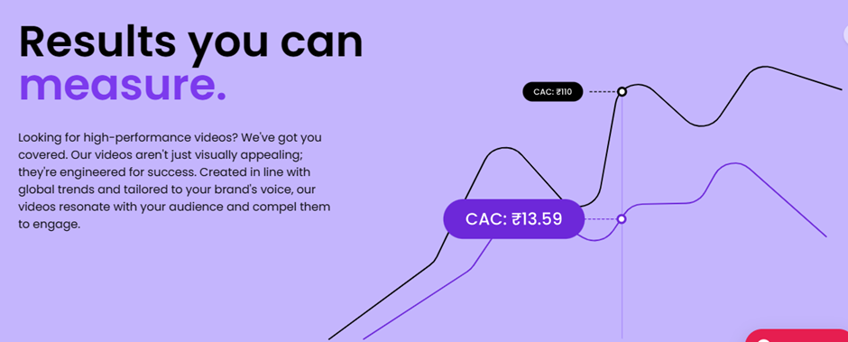
DOWNLOAD THIS PRESENTATION AS
A POWERPOINT TEMPLATE IN 3 STEPS

Slide 7
Conclusion:
Hypergro presents a favorable opportunity for prospective influencers by providing a wide range of functionalities to facilitate content creation, community engagement, and revenue generation. With a few modifications especially in privacy policies, it may grow even more powerful as a tool for social media influencers.

Slide 8
THANK YOU!
Feel Free to contact at mdshadab1107@gmail.com

